Slide 1
The Flappy Bird Project

Slide 2
Overview
# We will explain strengths and limitations at the end
we had divided the code into the following modules:
main: contains a high-level runtime life cycle
settings: mostly stores game settings
runtime_globals: stores shared variables
io_init_and_kb: initializes I/O and has keyboard press processing functionalities
draw: for drawing frames, it draws birds and pipes, the latter has rasterization hooks for generation and cleanup of pipes
update: processes logical events, with update() being called each frame
utils: made to contain loosely coupled functions, currently has one function

Slide 3
The flappy bird coordinate system
—------->
|
|
\/ A top-down coordinate system is used, with the position of objects stored as the upper-leftmost character

Slide 4
Key Structures
The pipe dictionary:
x: the pipe’s x offset
y: the pipe’s y offset (the y line matching the higher ------ line of the pipe)
passed: whether the bird had already moved past the pipe
The canvas: a 2d list where each element is a list of characters representing a row, we used a list of characters as opposed to a string for fast and simple access of pixels (simple because strings are immutable, while lists aren’t)

Slide 5
Main.py _{(by order of execution)}
initialize():
Clears the screen (to not have leftover characters from the previous commands)
Generates the first pipe(the rest are generated when a pipe moves fully into the canvas (detection is in draw.py))
Reads the high score
Note: it does logical initialisation, while io_init_and_kb does os-specific I/O initialisation
load_high_score():
Returns the high score form highscore.txt, if the file does not exist, it returns 0 and writes ‘0’ to the file

Slide 6
Main.py _{(by order of execution)}
main_loop():
Draws the game scene
Updates the game state (by calling update())
Processes the last key press since the last frame’s end
Sleeps for for 1/framerate many seconds (which roughly means that the loop will run framerate many times per second)
the loop stops if update() returns False, as that indicates the end of the game in our case
show_game_over_screen(): basically waits for the user to press a key before quitting

Slide 7
settings.py
debug: this is a flag covering whether debug mode is on or not, if True gravity would be disabled and the tester can step-through the game based on key presses, it can be used for collision testing and score update testing, if False, the normal game runs
width: the width of the game in characters (int)
height: the height of the game in characters, it was set in a way that maintains a 16:9 ratio based on width (there is a division over 2 because in most terminals the height of a line is the same as the width of two characters) (int)

Slide 8
settings.py
frame_rate: the maximum amount of times the main loop could run per second, typically the actual value should be close
scroll_speed: the speed of the pipes (the pipes move backward while the bird is stationary) (int)
bird_x: bird’s x position (int)
bird_acceleration: gravity (float)
bird_jump_velocity: the velocity the bird gets if it jumps (float)
bird_image: the characters representing the bird, it mimics the canvas structure, note that it’s not as flexible as the code implies, collision has the bird’s dimensions hard-coded

Slide 9
settings.py
min_pipe_distance_slack_factor: effectively sets the ratio of the minimum estimated viable pipe distance, and the actual minimum pipe distance used (float)
max_to_min_pipe_distance_factor: the ratio of the minimum pipe distance and the maximum pipe distance, this is not absolute; it is clamped due to limitations in pipe events (float)
pipe_width: the width of the pipe (int)
gap_height: the height of the gap + 2 (as it includes the ------ lines) (int)
A hook in programming often means a function that could be called at an event
shift_bird_y(sh): used for hooks in debug_key_actions
debug_key_actions: a dictionary of the hooks set in debug mode, where the key of the dictionary is the key press as a character, w moves the bird up, s moves the bird down, d moves the pipes backwards (as if the bird moves forwards)

Slide 10
settings.py
set_bird_vel(v): used for normal_key_actions
normal_key_actions: a dictionary of the hooks set in normal mode(debug = False mode) where the key of the dictionary is the key press as a character, space sets the bird’s velocity to the bird_jump_velocity setting, resetting the acceleration build-up in the process
key_actions: holds a pointer to the active key hooks dictionary (selected based on the debug flag)

Slide 11
runtime_globals.py
score: current score
high_score: current high score updated as soon as the high score is broken
pipes: a list of active pipe instances (each pipe is as described in the key structures section)
bird_y: the current line the bird is at in the canvas
bird_velocity: the current velocity of the bird

Slide 12
io_init_and_kb.py
Note: we are not OS API experts, nor python experts, and as such, we had used considerable help to write this module
As soon as the module loads it tries to import the msvcrt module, a Windows™-only module, if we are in *nix, the import will throw an exception, skipping the windows only code, otherwise *nix specific code(written in the expect block) will run
Note: *nix basically means unix-likes, which includes linux, mac os and the bsd’s, though we had only tested code on linux
Windows™ stub: we ‘or’ the current console mode for stdout state with 100b, which enables virtual terminal processing, this should allow us to use terminal-controlling ascii escape sequences if we are not allowed already

Slide 13
io_init_and_kb.py
2. *nix stub:
We set an is_unix flag to True, this is useful for other functions
It sets the standard input to be non-blocking this makes reads on stdin return instantly (even if there is no input)
We store terminal state before setting standard input to use cbreak mode, cbreak mode allows read calls s to return characters as soon as a character is inserted, as opposed to returning as soon as enter is pressed
We also register a hook on exit so that we can reset the terminal to the state just stored

Slide 14
io_init_and_kb.py
get_last_ch():
This function returns the last character from the relevant queues (which basically store key presses), this function clears the queues in the process, effectively this function returns the last character pressed since the last time this function was called (if any were pressed..)
If no ‘supported characters’ are pressed (or if none at all were pressed) the function will return an empty string
If we are in *nix os-es we use read() and return the last character from the returned string
If we are on windows we run a loop that drains getwch’s queue (by running a while as long as kbhit returns True)

Slide 15
io_init_and_kb.py
process_ch(ch): Checks if the ch is mapped in the settings.key_actions dictionary, if so it calls the appropriate routine
process_last_keypress(): Calls process_ch with the value of get_last_ch

Slide 16
draw.py
canvas_fill: the character used to fill the canvas initially
canvas: the only instance of the canvas structure explained earlier (basically a list of elements where each element is a list of characters)
clear_terminal(): it clears the terminal, which makes that the characters present before
running the game get wiped
draw_frame(): the highest-level draw_* function, it:
clears the canvas
draws the pipes (and runs the rasterization hooks)
draws the bird based on the bird_x setting and the bird_y global
prints the canvas

Slide 17
draw.py
clear_canvas(): it clears the canvas, without changing the canvas pointer
draw_px(ch, x, y): the lowest level draw_* function, it:
only overwrites the character at position (x, y) with the character ch if the position is in the boundaries of canvas
returns whether the character was in the canvas’ bounds or not

Slide 18
draw.py
draw_pipes():
It tries to draw the oldest pipe, if the pipe didn’t overwrite any pixel update.delete_first_pipe() will be called, deleting the pipe
It draws the rest of the pipes but the last
It tries to draw the newest pipe, if the pipe did overwrite all the pixels that could be overwritten, then the pipe is fully inside the canvas, and update.generate_pipe() would be called, making a newer pipe

Slide 19
draw.py
draw_pipe(canvas, pipe, canvas_width, canvas_height): It tries to draw a pipe pair based on the pipe struct passed
draws the top pipe’s vertical edges (ones made of the | character) row by row top to bottom
draws the top horizontal edge (made of the - character), then the bottom one, both column by column, left to right
mind that gap_height is inclusive of the horizontal edges
It draws the bottom pipe’s vertical edges (ones made of the | character) row by row top to bottom
The function compares the number of iterations in loops described in 1. to the number of the pixels successfully overwritten, returns a tuple of whether the numbers matched (thus whether the pipe is fully inside the canvas), and whether there were no overwritten pixels (thus whether the pipe is fully outside the canvas)

Slide 20
draw.py
test_draw_pipe(x, y): Shows how would a pipe be rendered at (x, y), and returns the tuple returned by the appropriate draw_pipe call
draw_bird(x, y): round()’s y to the nearest integer then calls draw_px for each column of each row of settings.bird_image with x and y set to the arguments + the offset within the image (effectively it copies settings.bird_image at the position (x, y))

Slide 21
draw.py
show(), it:
Sets the terminal cursor to 0, 0 (preventing scrolling, which looked glitchy in Windows™)
Prints the score and the high score
Joins the elements of the canvas making each element a string representing a line, and joins such strings with new lines
Sets a border variable to a string of settings.width many asterisks (*)
Joins the following elements in this order: cursor reset sequence + scores, border, canvas and border, with newlines
Flushes the standard output just in case

Slide 22
update.py
update(): this function runs after every frame is drawn, It:
It stores whether the bird had collided in a variable
If the debug mode is off, it would
Move the pipes backwards (which gives the illusion that the bird had moved forward)
Update the bird’s y position based on velocity
Update the bird’s velocity based on its acceleration
Checks if the score can be increased and would update it consequently
Updates the high score (both the variable and the file) if the score was updated
Returns whether the game could continue (inverts the variable of point 1 then returns it)

Slide 23
update.py
move_pipes(): it shifts every pipe’s x position in runtime_globals.pipes by -settings.scroll_speed
increase_score(): checks every pipe, and if a pipe didn’t increase the score and was fully behind the bird, the pipe will be marked, and the score would be increased
update_high_score(current_score, current_high_score): if current score > the current highscore, write the new highscore to highscore.txt, it effectively returns the new highscore

Slide 24
update.py
check_collision(bird): it returns True if:
the bird is above y=0, at or below y=height
If the bird is between the vertical lines of any pipe (inclusive), and if it’s y value is either:
2.1 above or at the pipe’s top horizontal line
2.2 or is below or at the pipe’s bottom horizontal line
Otherwise it returns False

Slide 25
update.py/approx_min_pipe_x_off(delta_y)
Notes:
idea and implementation we got without outside help
The function isn’t 100% accurate, for example: assumes the every relevant point is well a point, it doesn’t care that something is a bird/pipe, and it uses round()
The derivation/explanation has rough edges, mainly regarding signs, the explanation of the signs used in the code is omitted
We will refer to the function later as minimum estimated x
You can say that the function:

Slide 26
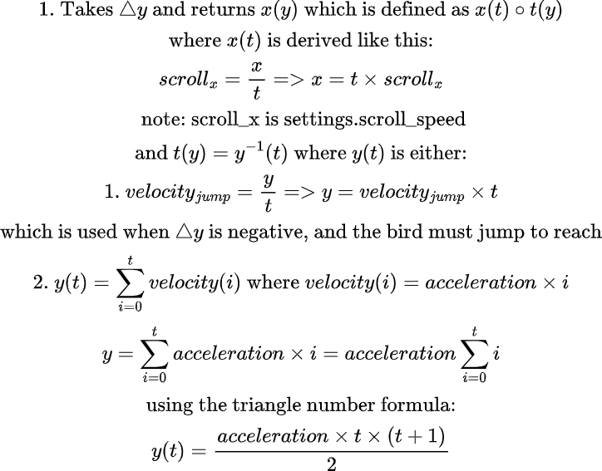
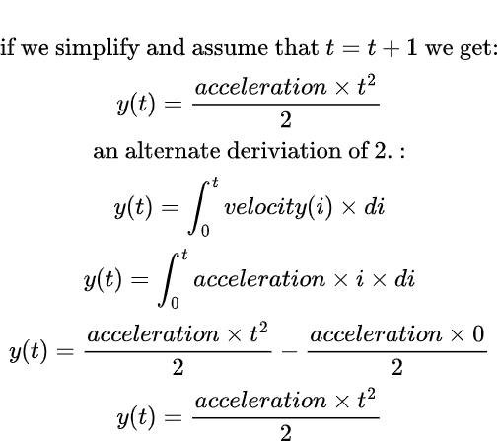
update.py/approx_min_pipe_x_off(delta_y)

Slide 27
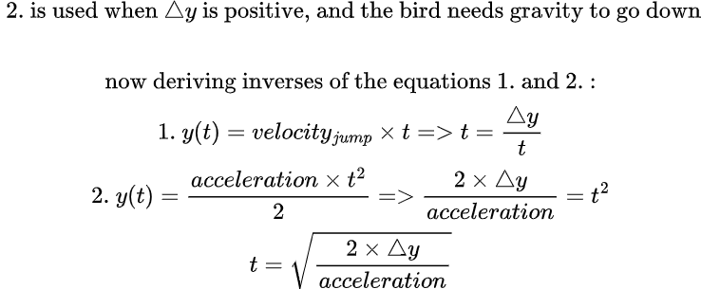
update.py/approx_min_pipe_x_off(delta_y)
Again, t is got based on either 1. Or 2. Based on whether arrival is jump bound or gravity bound(eq 1 is arguably simple because acceleration is reset if you keep pressing space), and then x is got based on t
velocity

Slide 28
update.py
generate_pipe():
Generates y randomly between [1, settings.height - settings.gap_height - 1)
If there are no pipes, there is no delta_y to pass the the min x estimator, and we simply generate a pipe at the edge
We store a minimum x offset defined as (minimum estimated x + 1) * slack factor
3.1. We will refer to the stored value as #3
We set x to settings.width + a random number between [#3, #3 * settings.max_to_min_pipe_distance_factor clamped to settings.width - 1]
4.1. We clamp because otherwise the game may crash as every pipe could be outside the canvas and get deleted
We set the passed flag to false, this is the flag used for score checking

Slide 29
update.py
delete_first_pipe(): removes the head pipe with O(n) time, we could have used a deque, but, the gains are minimal, and time is short, and we wanted to keep some stuff simple

Slide 30
Strengths
The code:
Cross-platform
Somewhat modular and configurable
Didn’t use any module outside python’s standard library
LLMs and internet had lightly helped in logic (it had mostly helped in I/O, one had used it for draw_pipe(), idk of other uses), and we wrote this documentation manually
We mathematically derived the minimum pipe distance that doesn’t make the game impossible (roughly speaking)

Slide 31
Limitations and Weaknesses
Using rasterization hooks had limited pipe generation and made us unable to safely generate pipes outside the canvas, as they may get deleted
Making stars outside the canvas had made the bird hitting them inconsistent with the bird hitting the pipes (visually), as the bird becomes invisible in the former case, but visible in the latter one
We had used O(n) many times where we could have used O(1), eg: in score checking and collision checking, and when removing the head pipe

